Slide 1

Steering Behaviors
Flocking & Other Techniques

Slide 2

Steering Behaviors
Steering behaviors dictate how an agent moves.
Steering behaviors:
Use a steering vector
Use (conflicting) behaviors as influences
Usually involve incremental changes
Usually produce lifelike behavior
Some common steering behaviors:
Individual Path Following
Crowd Path Following
Flocking

Slide 3
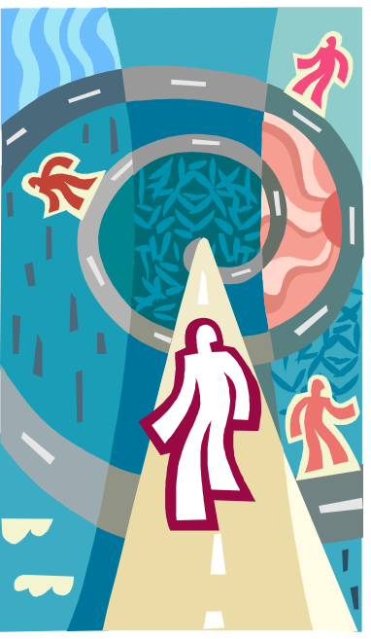
Path Following
Path Following is a steering behavior used to follow a target path.
Path Following:
Operates on a predefined path
Follows general direction of path
Applies a force in the direction of the path
Path Following isn’t:
A rigid process to match a path
A way to find a valid path
Crowd Path Following introduces separation.

Slide 4

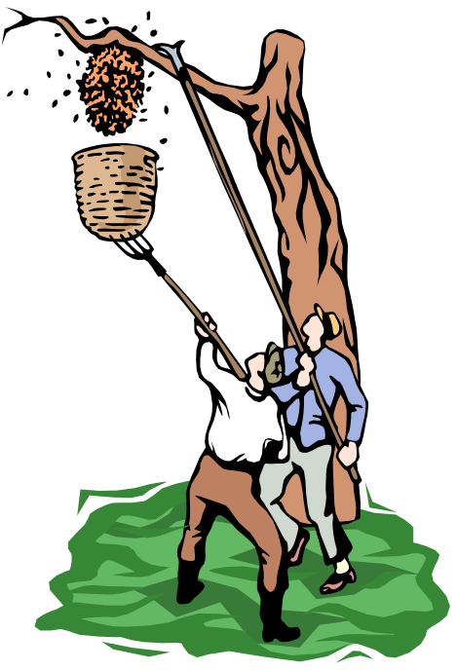
Flocking
Flocking is a steering technique that incorporates
several factors to create lifelike flocking behaviors.
In Flocking:
Individual agents have their own steering vectors
Influence of behaviors determined by a strength weight
Behaviors influence individuals incrementally
Direction changes often determined by group average
Three main forces are used in flocking to generate
group behaviors:
Alignment
Cohesion
Separation

Slide 5
Flocking:
Data Structures
class Flock
{
<Boid*> boids;
avgForward;
avgPosition;
alignmentStrength;
cohesionStrength;
separationStrength;
CalcAlignmentAccel();
CalcCohesionAccel();
CalcSeparationAccel();
Update();
}
Flock::Update(deltaTime)
{
calculate avgForward;
calculate avgPosition;
for each boid in boids:
{
accel = CalcAlignmentAccel(boid);
accel += CalcCohesionAccel(boid);
accel += CalcSeparationAccel(boid);
accelMultiplier = boid->maxSpeed;
accel *= accelMultiplier * deltaTime;
boid->velocity += accel;
if boid->velocity’s magnitude > boid->maxSpeed,
{
normalize boid->velocity;
boid->velocity *= boid->maxSpeed;
}
boid->update();
}
}

Slide 6
Flocking:
Data Structures
Vec3 Flock::CalcAlignmentAccel(boid)
{
vector = averageForward / boid->maxSpeed;
if (vector’s magnitude > 1),
normalize vector (to cap speed);
return vector * alignmentStrength;
}
Vec3 Flock::CalcCohesionAccel(boid)
{
vector = averagePosition – boid->position;
distance = vector’s magnitude;
normalize vector (to get directional unit vector);
// Set the speed based on distance from the flock.
if (distance < flockRadius)
vector *= distance / flockRadius;
return vector * cohesionStrength;
}

Slide 7
Flocking:
Data Structures
Vec3 Flock::CalcSeparationAccel(boid)
{
sum = emptyVector;
foreach (otherBoid in boids)
{
vector = boid->position – otherBoid->position;
distance = vector’s magnitude;
safeDistance = boid->safeRadius + otherBoid->safeRadius;
// If a collision is likely...
if (distance < safeDistance)
{
// Scale according to distance between boids.
normalize vector (to get directional unit vector);
vector *= (safeDistance - distance) / safeDistance;
sum += vector;
}
}
if (sum.Length() > 1.0f)
normalize sum (to cap speed);
return sum * separationStrength;
}

Slide 8
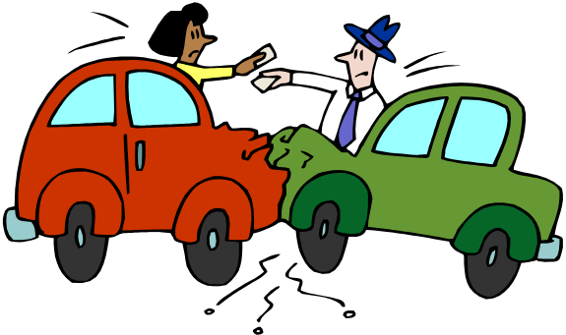
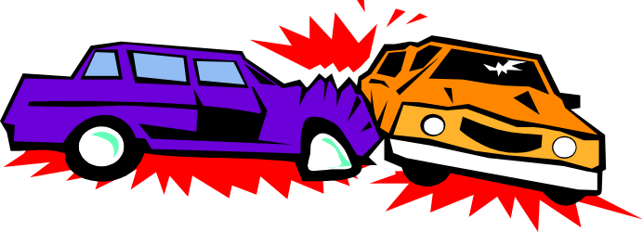
Collision Avoidance
To avoid agent collisions, we should consider speed as well as direction, especially for human agents.
Try slowing down or stopping agents to avoid collisions – turning constantly can look unnatural
A good way to do this is separate out desired speed and direction from actual speed and direction (which is also great for animation)
Make sure agents don’t pick the same avoidance direction!
Parameters can be tweaked to model personalities

Slide 9
Steering Behaviors
Benefits & Drawbacks
Benefits
Agents retain individual, lifelike behaviors
Group vectors allow for simple, cheap calculations
Behavior influence on flock can be increased or reduced easily
Weight adjustments are immediately realized in agent behavior
Agents react quickly to changes or obstacles in the world
Drawbacks
Don’t work well in indoor environments or with lots of obstacles
Don’t work well for single agents, which can be a little erratic or unintelligent
Can be prone to oscillation
Can require a lot of tweaking
Only evaluate locally – not as good as real path planning
No built-in constraints, like keeping out of certain areas

